Slide 1
Quantum Computing
Grover's Algorithm

Slide 2
Concept
Quantum parallelism – making queries in parallel
Speed enhancement: O(N) ---> O(√N)
Can be used for database search query
Initialize to ON states
Convert these qubits into |1> states using NOT gates
Superposition
Create a uniform superposition of these qubits using the Hadamard gates
Oracle
Define an Oracle function which will track the required qubit and negate its amplitude
Grover's operator
Use the Grover's operator to flip every amplitude around the average
Steps
1
2
3
4
5
3 qubit system
Start with 3 qubits which are in |0> state by default

Slide 3






Gates
Controlled gates:
Pauli X gate/NOT Gate
Rotation around X-axis
X|0> = |1>
Pauli Z Gate
Rotation around Z-axis
Z|0> = |0>
Hadamard Gate
H|0> = |0> +| 1>
X|1> = |0>
Z|1> = -|1>
H|1> = |0> -| 1>
1st and 2nd qubit in are 0 & 1
1st and 2nd qubit in the circuit are the bottom and the top respectively
Check if the 2nd qubit is 1, as indicated by the filled – circle on the top line line
If yes, apply NOT on the 1st qubit as indicated by the NOT symbol on the bottom line. Else do nothing
Single-qubit gates
Oracles
|101>
|011>
|010>

Slide 4
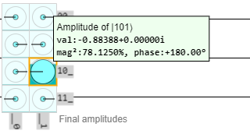
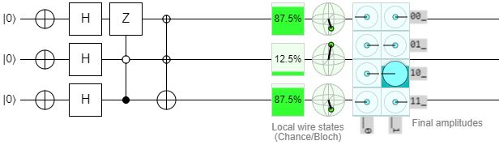
Implementation
Oracle mapped to |101> qubit
Probability of each qubit in |1> state or ON state
8 possible cases
Pauli X Gate
3rd qubit
2nd qubit
1st qubit
Creates superposition
of qubits
Grover's operator
Link to the actual quirk circuit interface:
https://algassert.com/quirk#circuit={%22cols%22:[[%22X%22,%22X%22,%22X%22],[%22H%22,%22H%22,%22H%22],[%22Z%22,%22%E2%97%A6%22,%22%E2%80%A2%22],[%22%E2%8A%96%22,%22%E2%8A%96%22,%22X%22]]}

Slide 5
Objective
Solution
Application
Understand the quantum algorithms
erte
ewe

